Slide 1

WAY TO ENTERPRISE
AWS
VTI ACADEMY
Author: duy.nguyenngoc1@vti.com.vn

Slide 2
Agenda
FSx Service
Storage Gateway Service
Snow Family Service
Assignments
Quiz
Copyright © VTI Academy All Rights Reserved

Slide 3
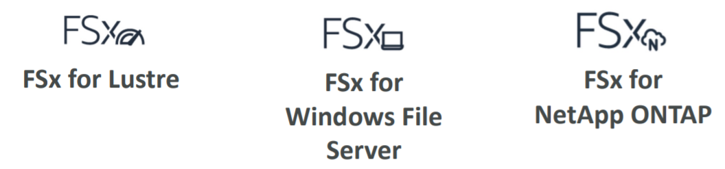
FSx Service
Launch 3rd party high-performance file systems on AWS
3 types
  FSx for Windows File Server
  FSx for Lustre
  FSx for NetApp ONTAP (new)
https://docs.aws.amazon.com/fsx/index.html

Slide 4
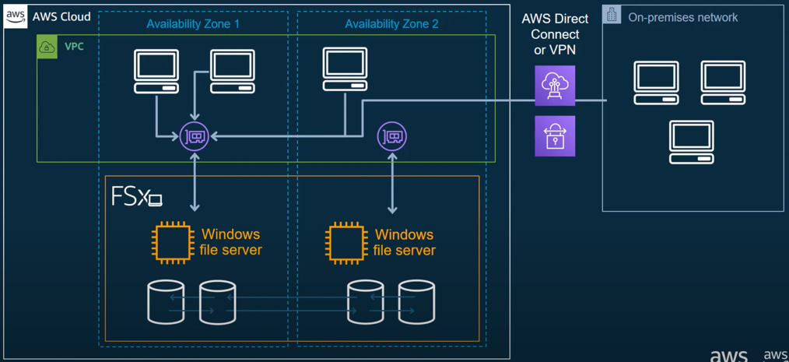
FSx Service
  FSx for Windows File Server
    Is a fully managed Windows file system share drive
    Supports SMB protocol & Windows NTFS
    Support data compression
    Data is backed-up daily to S3
    Built on SSD, scale up to 10s of GB/s, millions of IOPS, 100s PB of data
    Integration with Active directory for on-premises Authentication & Authorization
Support Multi-AZ (high availability), Automatic failover

Slide 5
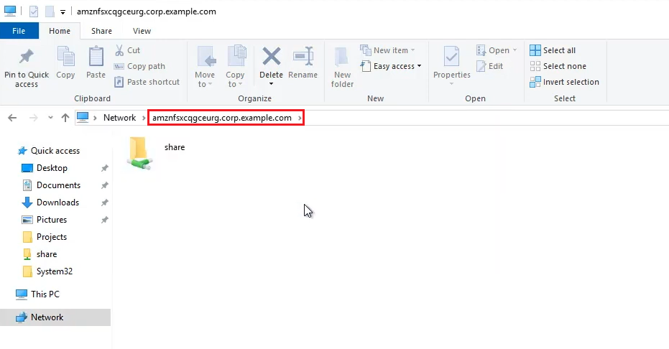
FSx Service
    Price: https://aws.amazon.com/fsx/windows/pricing/
    Use cases
      Migrate Windows file servers to AWS
Support accessing from on-premises infrastructure

Slide 6
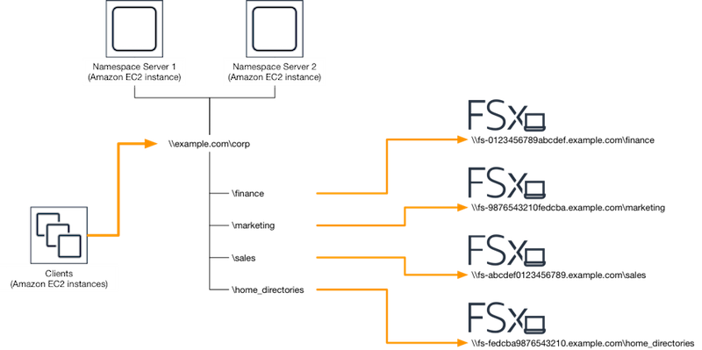
FSx Service
      DNS namespace
After creating FSx, AWS will provide domain for accessing

Slide 7
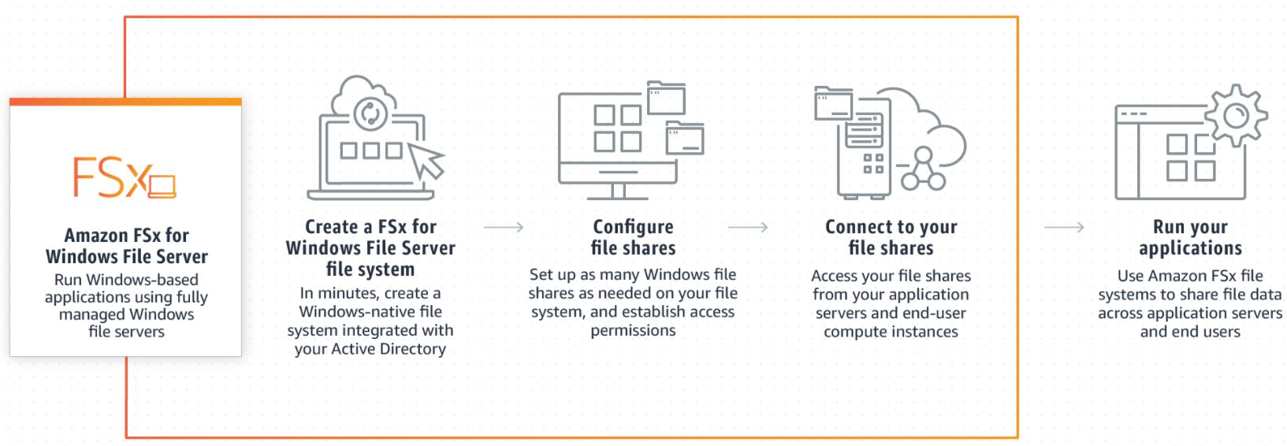
FSx Service
    Demo
Tutorial: https://www.youtube.com/watch?v=IMDWTIShlyI
https://docs.aws.amazon.com/fsx/latest/WindowsGuide/getting-started.html

Slide 8
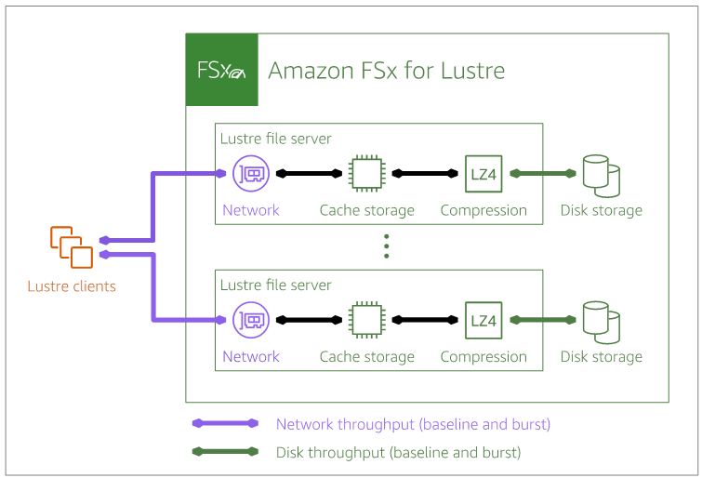
FSx Service
  FSx for Lustre
    Is a type of parallel distributed file system, for large-scale computing
    Lustre stands for "Linux" and "cluster" (Only support Linux)
    Support data compression
    Support Multi-AZ (high availability), Automatic failover
    Scales up to 100s GB/s, millions of IOPS, sub-ms latencies
    Support accessing from on-premises infrastructure
    Integration with S3 (read/ write to S3 as a file system through FSx)

Slide 9
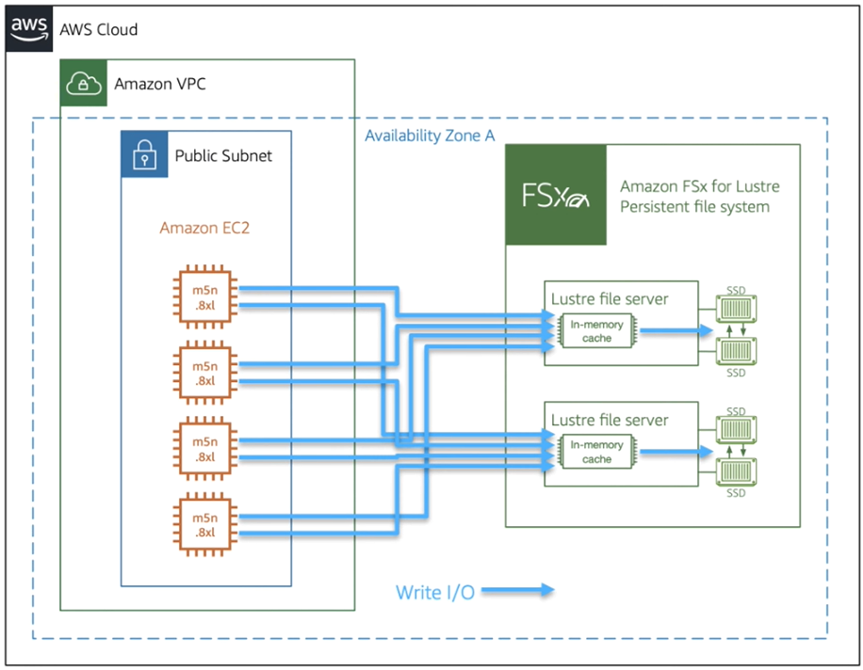
FSx Service
    Usecases: compute-intensive workloads
      Machine Learning, High Performance Computing (HPC)
      Video Processing, Financial Modeling, Electronic Design Automation
    Price: https://aws.amazon.com/fsx/lustre/pricing/

Slide 10
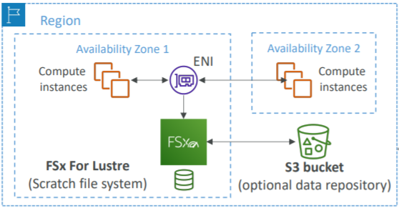
FSx Service
    Deployment Options
      Scratch File System
        Temporary storage
        Data is not replicated (doesn’t persist if file server fails)
        High burst (6x faster, 200MBps per TiB)
        Usage: short-term processing, optimize costs

Slide 11

FSx Service
      Persistent File System
        Long-term storage
        Data is replicated within same AZ
        Replace failed files within minutes
        Usage: long-term processing, sensitive data

Slide 12
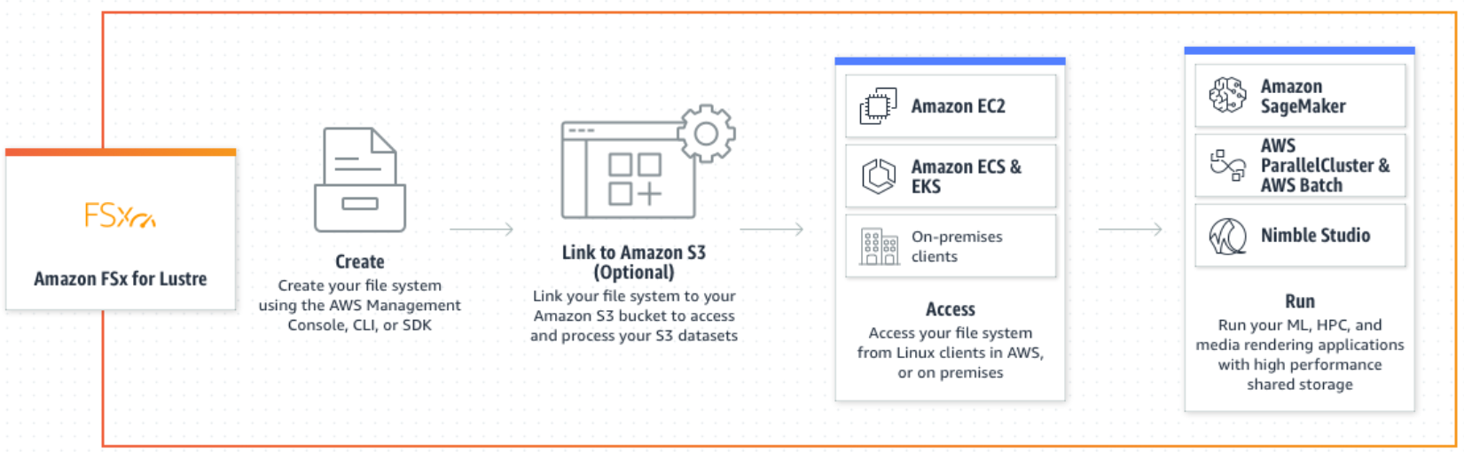
FSx Service
    Demo
Tutorial: https://www.youtube.com/watch?v=ttCAqwnN_Qo
https://docs.aws.amazon.com/fsx/latest/LustreGuide/getting-started.html

Slide 13
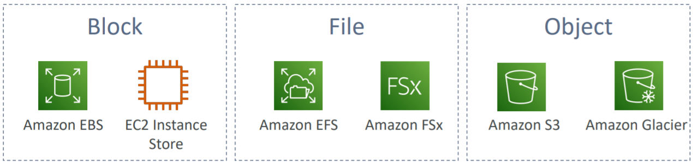
Summary

Slide 14
Assignment
  Self-practice

Slide 15
Q & A
Copyright © VTI Academy All Rights Reserved

